Slide 1
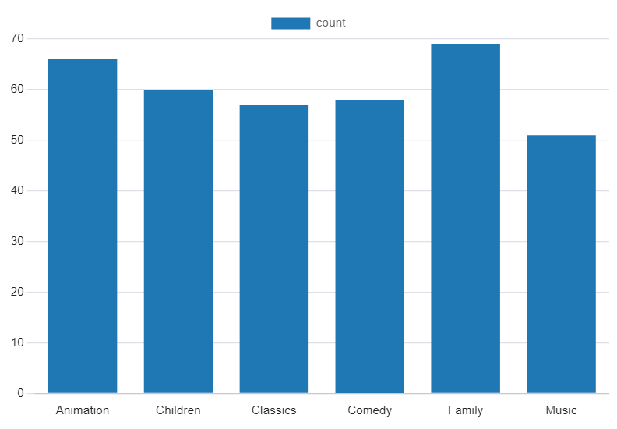
The categories of movies that families watch most
The movie categories that families watch most are "Family" and "Animation," with 69 and 66 rentals, respectively. These two categories are the most popular among family audiences based on the number of rentals recorded.
Notes:
SELECT DATE_TRUNC('month',rental_date) AS mon, staff_id,
COUNT(rental_id)
FROM rental
GROUP BY mon, staff_id
ORDER BY mon, staff_id
/* This query isn’t as complex as yours should be, as there isn’t a join - this is just an example template of what your ending slide should like */

